Slide 1
CSE-442 Microprocessor And Microcontroller.
Title: Morse Code Decoder

Slide 2
Morse Code Decoder
Group members:
Armin Haque
ID:2014-2-60-069
S. M. Ruhul Kabir Howlader
ID:2014-2-60-089
Md. Nuruddin Qaisar Bhuiyan
ID: 2014-1-60-069
Submitted To,
Dr. Nawab Yousuf Ali
Associate Professor
Department of Computer Science & Engineering

Slide 3
What is Morse Code?
Transmitting text information via different medium.
Invented by Samuel F. B. Morse.
The most used medium for morse code is Electricity.
Morse code is less sensitive to poor signal conditions.
Easy to establish.
Very useful in times emergency (Earthquake etc.)
Input signal is a pattern of
Dots (short pulse of duration 0.67 second) and
Dashes (long pulse of duration greater than 0.67 second).

Slide 4
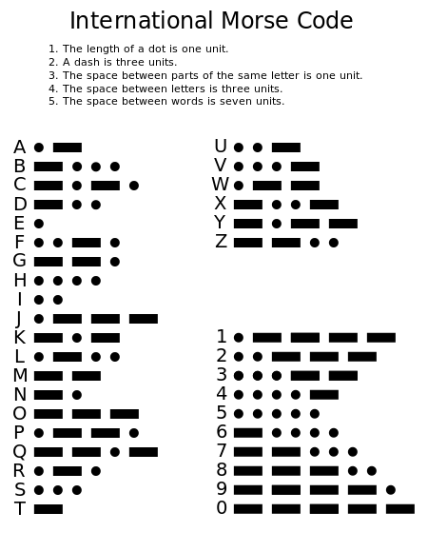

Slide 5
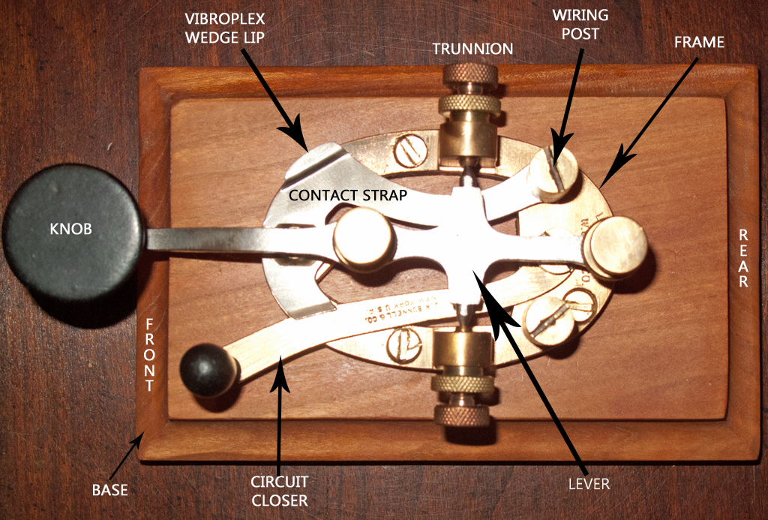
Morse Code Decoder
Fig: Ancient morse code transmitter.

Slide 6
Arduino Benefits In This Project
Easy to use .
Much more Reliable .
Debugging:-The arduino Environment provide easiest debugging environment which is cross-platform and is accepted by every member of the family.

Slide 7
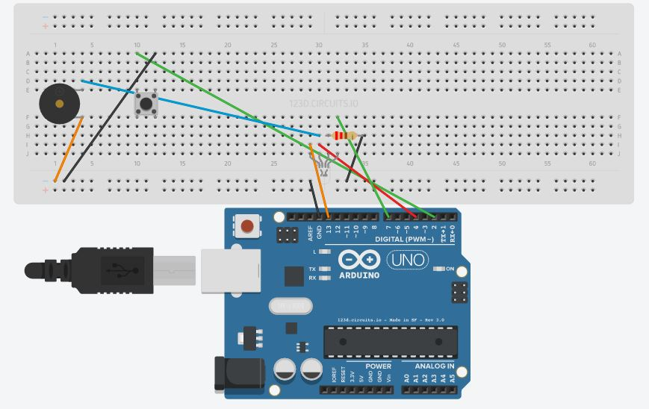
Circuit Diagram

Slide 8
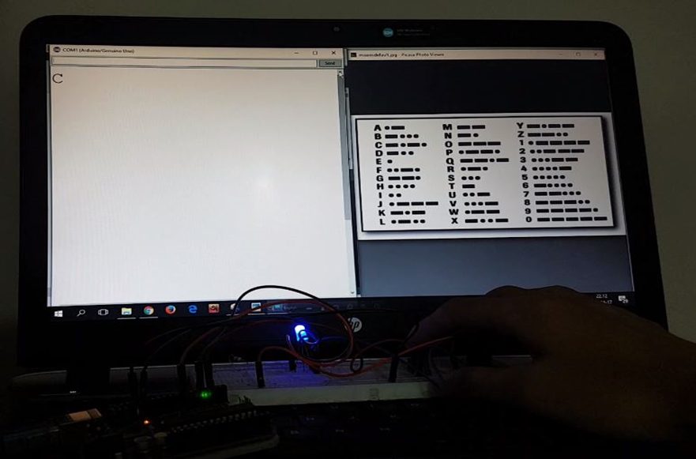
Testing Result

Slide 9
Limitations
Needs months of practice to send accurate morse code.
Long distance transmission requires constant electricity.
All other medium are used in short distance.

Slide 10
Conclusion
Throughout this semester we learned about different types of microcontrollers. By doing this project we have learned how real life problem can be solved with the help of the microcontrollers. We also learned some simple simulations with the help of Arduino which may be helpful to our jobs or research.

